Slide 1

Xamarin Forms esencial
by Israel Calderón de la Cruz

Slide 2


¿What is Xamarin Forms?
Xamarin.Forms is an open source cross-platform framework from Microsoft for building iOS, Android, & Windows apps with .NET from a single shared codebase.
Notes:
Miguel de Icaza

Slide 3

Application Framework
Xamarin.Forms is more than just a cross-platform UI library, it is a full application framework that includes everything you need to build mobile apps. This includes cross-platform navigation, animation APIs, dependency service, messaging center, and more.

Slide 4

Model-View-ViewModel (MVVM)
MVVM is a design pattern used to decouple user-interface (view), data (model), and application logic (view model). Xamarin has built-in support for the MVVM pattern including data binding, making it easy to follow this design pattern so that you can create application code that's better tested and easier to extend without requiring radical changes.

Slide 5
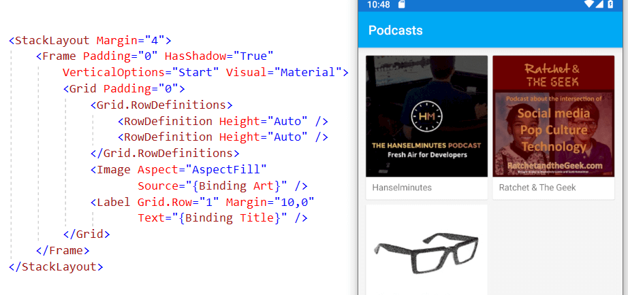
Declarative User Interface or not
Build user interfaces declaratively with XAML and share them across mobile and desktop platforms. However, if XAML is not your cup of tea, you can create equally powerful and performant UIs using C# instead.

Slide 6
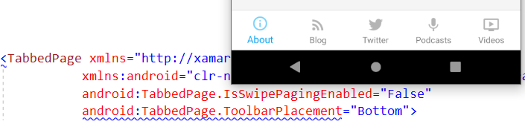
Access native platform features
Easily integrate native user interface features with platform specifics such as iOS Safe Area, Android elevation, and Windows ListView selection mode both from C# and XAML.

Slide 7

Consistent user interface design
The Visual API in Xamarin.Forms helps to deliver a consistent Material Design look and feel across your iOS and Android apps. Visual includes built-in support for Material Design and is fully extensible.

Slide 8

UI component ecosystem
Get productive fast with reusable UI components from top component vendors like Syncfusion, DevExpress, UX Divers, GrapeCity, Telerik, and others.

Slide 9
Xamarin support will end on May 1, 2024
https://dotnet.microsoft.com/en-us/platform/support/policy/xamarin

Slide 10
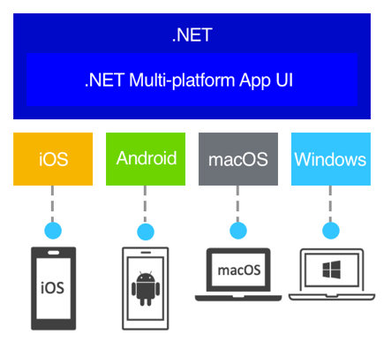

.NET Multi-platform App UI

